Slide 1
NAME: PRIYAL ADROJA
DEPARTMENT: INFORMATION & TECHNOLOGY(IT-1)
ENROLL. NO.: 160410116002
SUBJECT: ENGINEERING ECONOMICS & MANAGEMENT
TOPIC: THEORY OF DEMAND & SUPPLY

Slide 2
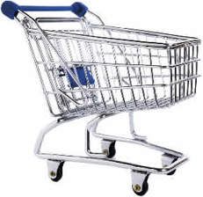
THEORY OF DEMAND & SUPPLY
WHAT IS DEMAND?
Quantities of a particular good or service consumers are willing and able to buy at different possible prices.

Slide 3
THE LAW OF DEMAND…
Consumers buy more of a good when its price decreases and less when its price increases.
When price Demand goes when price Demand
goes up… down… goes down… goes up…

Slide 4
THE DEMAND CURVE
Price($)
Quantity demanded(t)

Slide 5
FACTORS OF DEMAND
Changes in income(the income effect)…
When income consumers buy
goes up more
When income consumers buy
goes down less

Slide 6
2. Prices or availability of substitutes(substitution effect)…
A substitute is a good that can be used in place of another.
3. Prices or availability of complementary goods…
Complementary goods are things that are often are sold or used together.
4. Changes in the number of buyers…
More people more sales.

Slide 7


5. Changes in tastes & preferences….
then… now…

Slide 8
WHAT IS SUPPLY?
Supply:
The amount of a product that is offered for sale at all possible prices in the market.

Slide 9
THE LAW OF SUPPLY
Tendency of suppliers to offer more of a good at a higher price and less at lower prices.
When price Supply When price supply
goes up… goes up… goes down… goes down…

Slide 10
THE SUPPLY CURVE
60
50
40
30
20
10
10 20 30 40 50 60 70
Price p
Quantity q

Slide 11
Difference is that…
The law of demand describes how price affects CONSUMERS…
And the law of supply describes how price affects PRODUCERS…

Slide 12
FA CTORS OF SUPPLY
Cost of inputs(factors of production)…
When production supply goes
costs go up down
When production supply goes
costs go down up

Slide 13
2. Changes in productivity…
when productivity supply
goes up goes up
when productivity supply
goes down goes down

Slide 14
3. Changes in the number of sellers in the market…
More sellers in a market=increase supply.
Fewer sellers in a market=decrease supply.

Slide 15
THE BEST PRICE…
The equilibrium price is where supply & demand intersect.
p
r
i Equilibrium price
c
e
Quantity

Slide 16
CASE STUDY
ONION PRODUCTION IN INDIA
Abstract:
Price variations in onions due to change in weather conditions and creating artificial demand. Study the pattern of production of onions in India, demand and export. Also study the impact of these changes in price on food inflation and economy.
Keywords: Onions, Floods, Government, Traders, Farmers,
Hoarders, Export, Inflation.
Onion is one of the important vegetable that forms of our daily diet. Onions are considered as good for health point of view since it is enriched with proteins in addition to its taste. Onion is an important commercial crop in India, particularly Kurnool in Andhra Pradesh and Nasik in Maharashtra. At present, India

Slide 17
stands second larger producer of onion in the world, next to china.
Demand for Onions is constant and sometimes it’s increasing due to seasons like festivals. Consumption of Onions in India is subject to fluctuations on account of religions considerations. Consumption of onions tends to decline when other vegetables are available at affordable prices. The amount of decline is considered as minimal, so there are no substitutes to Onions, the demand considered as In-elastic in nature.
Production of Onions from India given in fig.1. It shows that production is increased gradually.

Slide 18
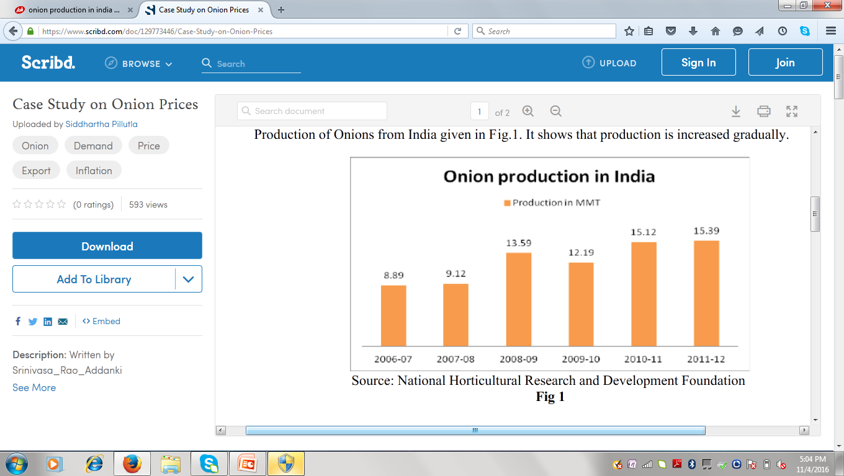
The damage caused to onion crops in parts of Maharashtra & Andhra Pradesh, the biggest producer in the country, due to unseasonal, erratic and heavy rains in the year 2010 and poor crop. Onions are consumed by everybody so you cannot afford for onion prices to go up.
In this situation, Traders forms a cartel and plays vital role in increasing or holding the prices, so traders will keep the stock for

Slide 19
further rise in prices and they are not allowing stock goes in to the market like in normal conditions. In other words traders operate the market for their benefits. They create an artificial scenario. The result of this is speculative interest and black-marketing of onions. Due to this farmers/traders will get better price but consumer can’t afford.
There was no decline in demand during the period, so mismatch in supply and demand numbers of which contributed to increse in prices. This mismatch is only in domestic markets, exports of onions are continued during this period as usual.
To bridge the gap between supply and demand government involved. The reduction in prices had started after government intervened with measured like export ban, abolition of import duty and asking state government’s to crackdown on onion hoarders. Due to this prices have come down a bit around Rs.55-65 a kg. From the fig.2, found that there was dip in exports in the year 2010-11.

Slide 20
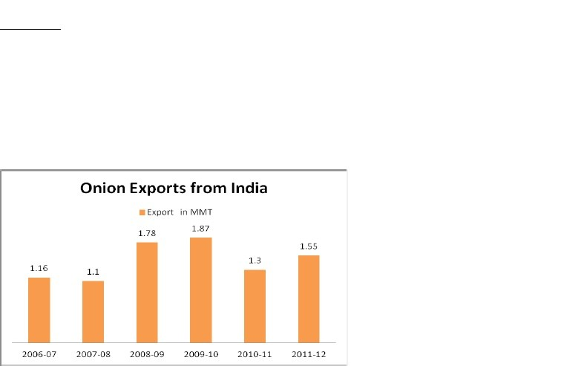
Rising in price and shortage in supply, during this period, demand curve was downward slopping. As a result of this type of either natural calamity or due to artificial rise in price created by Traders, supply reduced against demand and impacts in raising food inflation. It directly impacts country’s economy.

Slide 21
Conclusion :
Policy makers from government side need to implement few things religiously to put situation back on track like here in this case of onion. In addition to ban on export, develop some irrigation system to avoid dependence on nature, arrange direct marketing from farmers like farmer bazaars(or fairs), strong punishment system for all hoarders and finally disaster recovery system like pre planned import structure just in case of any natural calamity or any such things happen in future. This way we will make our economy very stable with respect to deviation in prices.

Slide 22
THANK
YOU…..

